Slide 1
Computations
Liam Costello, Michael Quinn, and Mitchell Boone

Slide 2
Computations Main Object
Create a CSV file that contains the analysis of student outcomes through:
Class Average
Class Median
Percent of Class scoring 3 or above

Slide 3
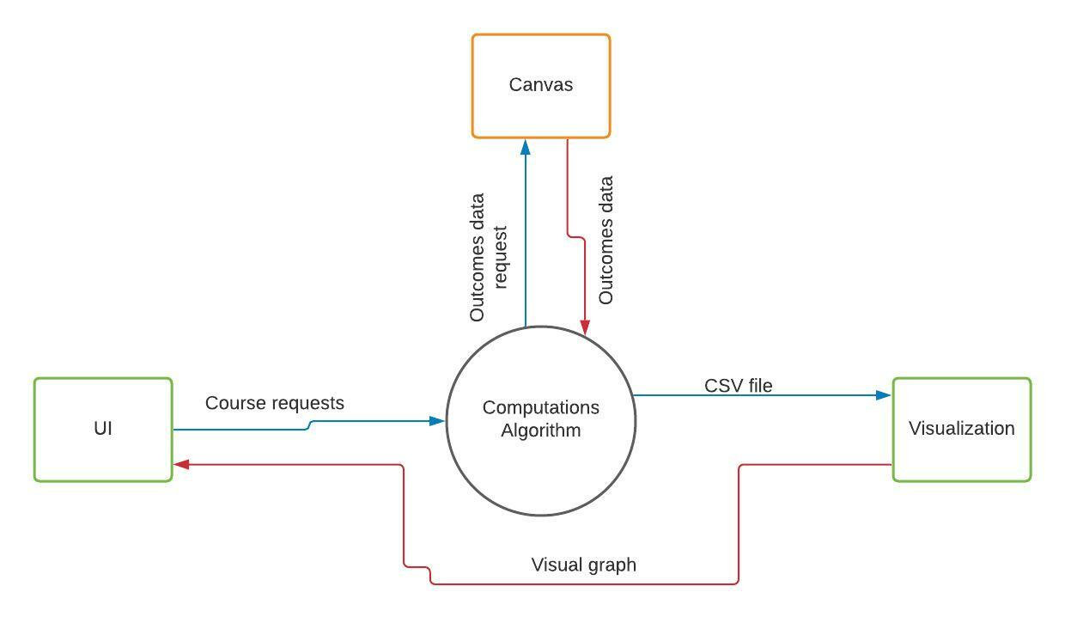
Requirements
Receive course requests from the user interface
Generate an Outcomes data request for Canvas
Receive Outcomes data from Canvas
Generate CSV file

Slide 4
Next Steps
Design Phase:
Layout File System for program
Data Flow diagrams
Create a Hierarchy Chart

Slide 5
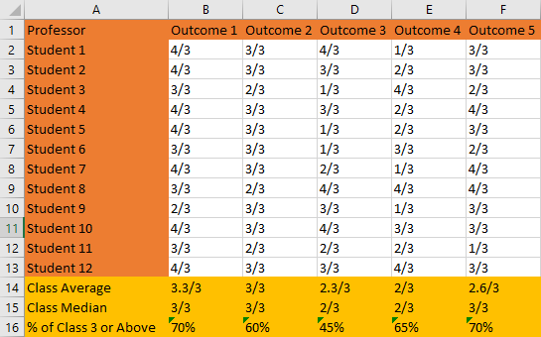

Slide 6
Questions?

